Slide 1
Ethical Considerations in AI
Week 13

Slide 2
Overview
Understand the ethical considerations associated with the development and deployment of artificial intelligence (AI) systems, including bias, fairness, accountability, transparency, and privacy.

Slide 3
Learning Outcomes
Identify and analyze key ethical considerations associated with the development and deployment of artificial intelligence (AI) systems
Discuss the implications of biased AI systems on society
Explore strategies and techniques for mitigating ethical concerns in AI

Slide 4
As machines make more decisions for us, we must ask: Are they making the right decisions? Are there instances that AI has made unethical outcomes?
Inadvertent uses of AI that exhibit inequities and intolerable biases, or to intentionally harm people and be destructive.
How to deal with AI going rogue? Is there an AI “prison”, or ways to penalize AI?

Slide 5
What moral principles or philosophies govern our behavior? What philosophy guides us on how we conduct any activity?

Slide 6
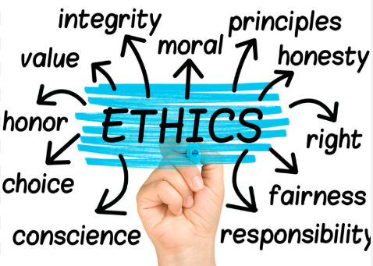

Slide 7


Slide 8
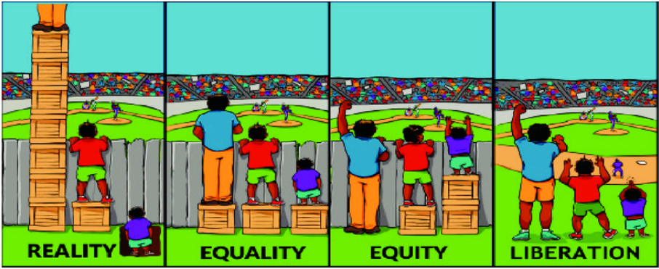

Slide 9
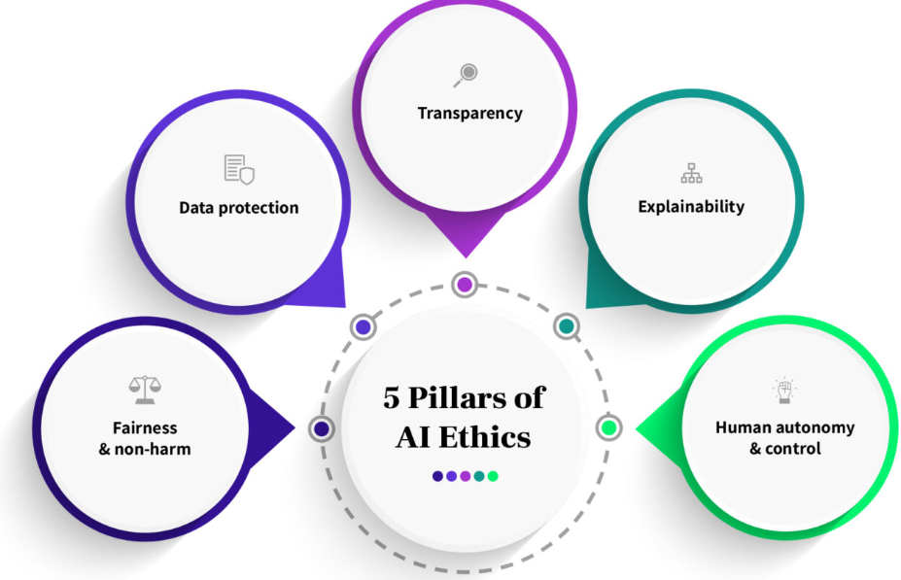
AI Ethical Issues
Bias and Fairness,
Accountability and Transparency,
Privacy.
TASK
Define the terms in context of AI and How it manifests in AI?
Notes:
1. Fairness and non-harm
Definition: This is all about averting harm and sidestepping the pitfalls of magnifying societal inequalities. AI, if not well-guided, can tread into unfair territories, especially when fueled by biased datasets or designs. The result? Discrimination, especially against minority groups.
2. Data protection
Definition: Guarding privacy is paramount. This encompasses seeking user consent before the data dance begins, letting users have a say in their data, and ensuring no leaky pipelines.
3. Transparency
Definition: In an AI context, transparency ensures the system doesn’t operate in stealth. It’s about keeping users in the loop—whether they’re engaging with AI, being the subject of an AI decision, or viewing AI-created content.
4. Explainability
Definition: Break it down! AI’s technical wizardry needs translation into human language. Such explanations enable everyone, from devs to end-users, to fathom algorithmic decisions and act if anomalies arise.
5. Human autonomy and control
Definition: No AI should go rogue! Humans must be in the driver’s seat, intervening when necessary and challenging automated decisions.

Slide 10
Ethical Dilemma: 3 Case Studies
Autonomous Vehicles
Scenario: An autonomous car is faced with an unavoidable collision. Does it prioritize the safety of its passengers or pedestrians?
AI in Recruitment
Scenario: A company uses AI to sift through job applications. The AI system, trained on past data, shows bias against certain demographic groups.
Predictive Policing
Scenario: Law enforcement agencies use AI to predict where crimes might occur or who might commit them.
Notes:
Ethical Dilemma: Autonomous Vehicles
Scenario: An autonomous car is faced with an unavoidable collision. Does it prioritize the safety of its passengers or pedestrians?
Challenges:
Programming morality: Can we code an ethical framework for machines?
Accountability: Who takes the blame in case of an AI-driven accident?
Public perception vs. statistical safety: Even if autonomous vehicles reduce overall accidents, public focus remains on AI-induced errors.
Ethical Dilemma: AI in Recruitment
Scenario: A company uses AI to sift through job applications. The AI system, trained on past data, shows bias against certain demographic groups.
Challenges:
Reflecting societal biases: If AI learns from historical data, it risks perpetuating existing biases.
Transparency and fairness: Applicants deserve clarity on how decisions about their candidature are made.
Impact on diversity: Over-reliance on AI might stifle workplace diversity.
Ethical Dilemma: Predictive Policing
Scenario: Law enforcement agencies use AI to predict where crimes might occur or who might commit them.
Challenges:
Data accuracy: Faulty data can lead to misguided predictions.
Profiling and privacy: The risk of unfairly targeting certain communities based on flawed or biased AI predictions.
Moral concerns: At what point does preventive policing become intrusive surveillance?

Slide 11
Group Task: 10 mins
Analyze the case study,
Identify ethical issues, and
Propose solutions or mitigation strategies.
Each group to share their findings and insights

Slide 12
Ethical Framework
Transparent Algorithms: Ensuring clarity in how AI models make decisions.
Ethical Audits: Periodic checks to ensure AI systems adhere to ethical guidelines.
Human-in-the-loop: Keeping human judgment as a crucial component, especially in critical decision-making scenarios.
Public Participation: Engaging society in discussions about AI's role and ethical boundaries.

Slide 13
Summary
Ethics is the backbone of AI implementation
AI, in its essence, is a tool – it reflects the data and intentions of its creators.
Addressing ethical dilemmas in AI is not just about refining the technology but also introspecting on societal values.
As we move forward, collaborative efforts between technologists, ethicists, and the public will be paramount to navigate the AI-driven future responsibly.
In the vast ocean of AI possibilities, let ethics be our anchor, ensuring we harness its waves responsibly, innovatively, and above all, ethically.

Slide 14
Reference
Case Study: Ethical Dilemmas in AI by ScaleBuild AI
https://www.linkedin.com/pulse/case-study-ethical-dilemmas-ai-scalebuildai/
AI Ethics And AI Law
https://www.forbes.com/sites/lanceeliot/2022/03/13/ai-ethics-and-the-riddle-underlying-criminal-accountability-of-ai-including-crimes-committed-by-revered-ai-based-self-driving-cars/?sh=56a889ac3dd5

